Slide 1
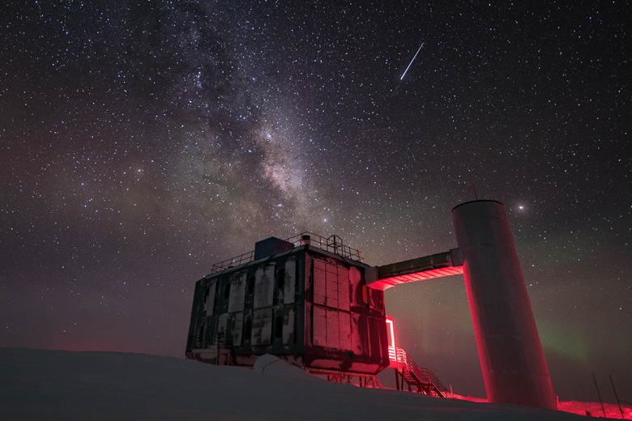
The IceCube Neutrino Observatory: The Perfect Muon Detector Unraveling Cosmic Secrets
Pascal Gutjahr
TU Dortmund University
pascal.gutjahr@tu-dortmund.de
LPC – Clermont-Ferrand
06.10.2023
icecube..wisc.edu

Slide 2
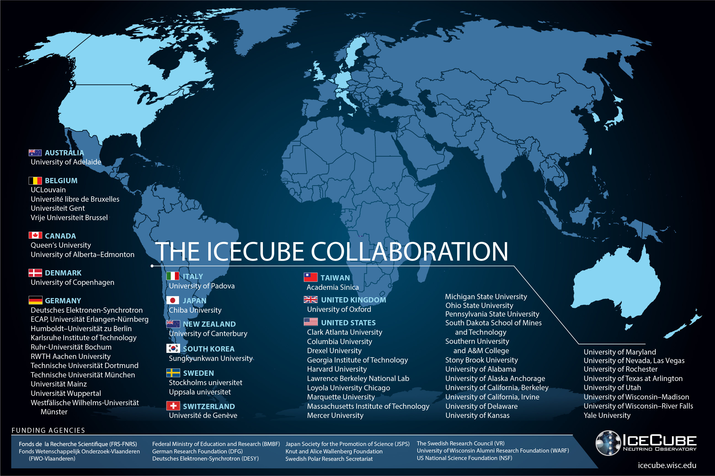

Slide 3
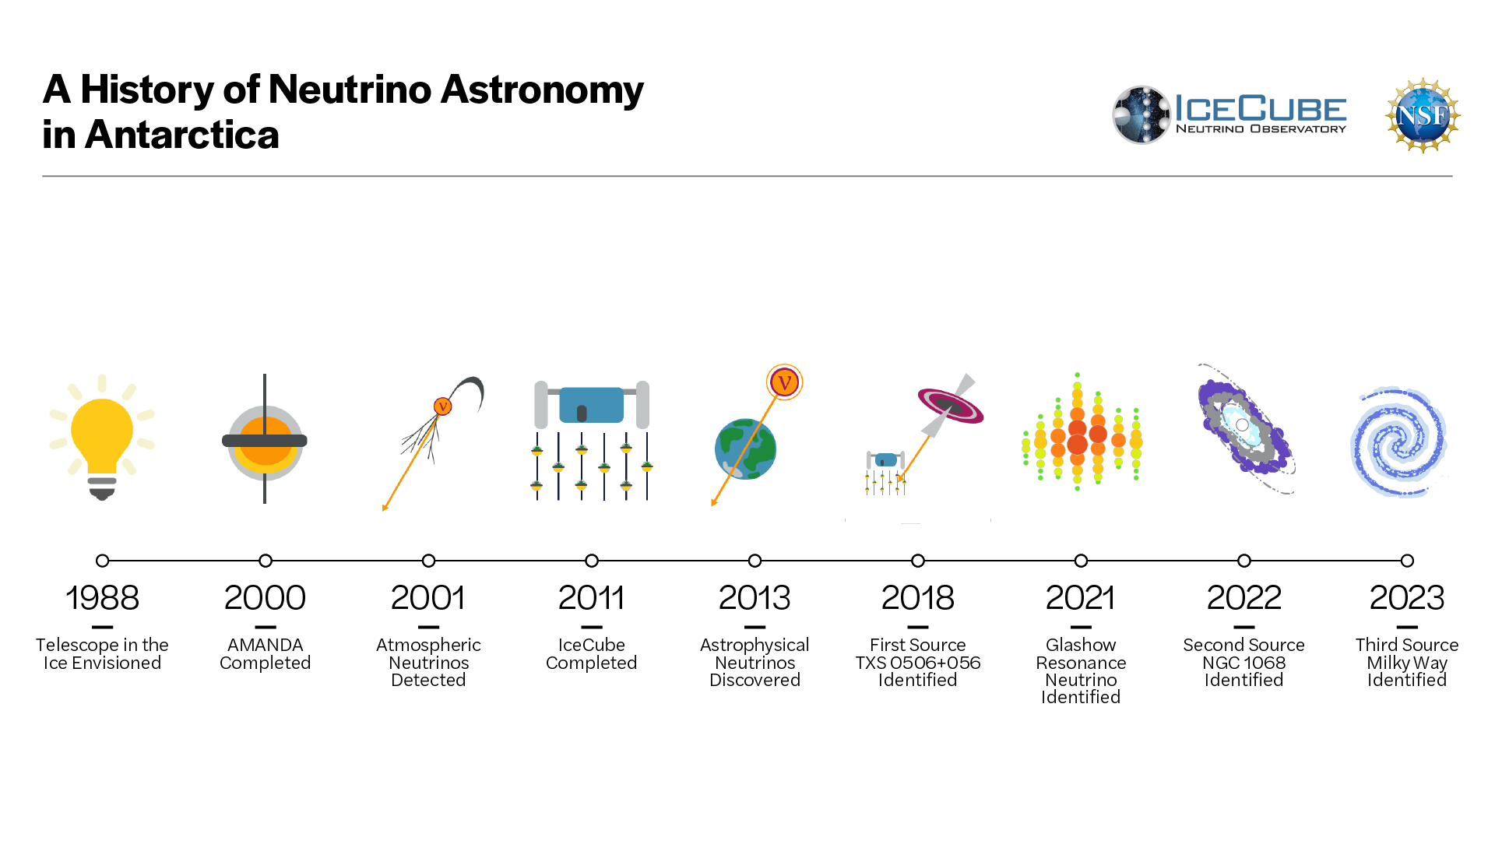

Slide 4
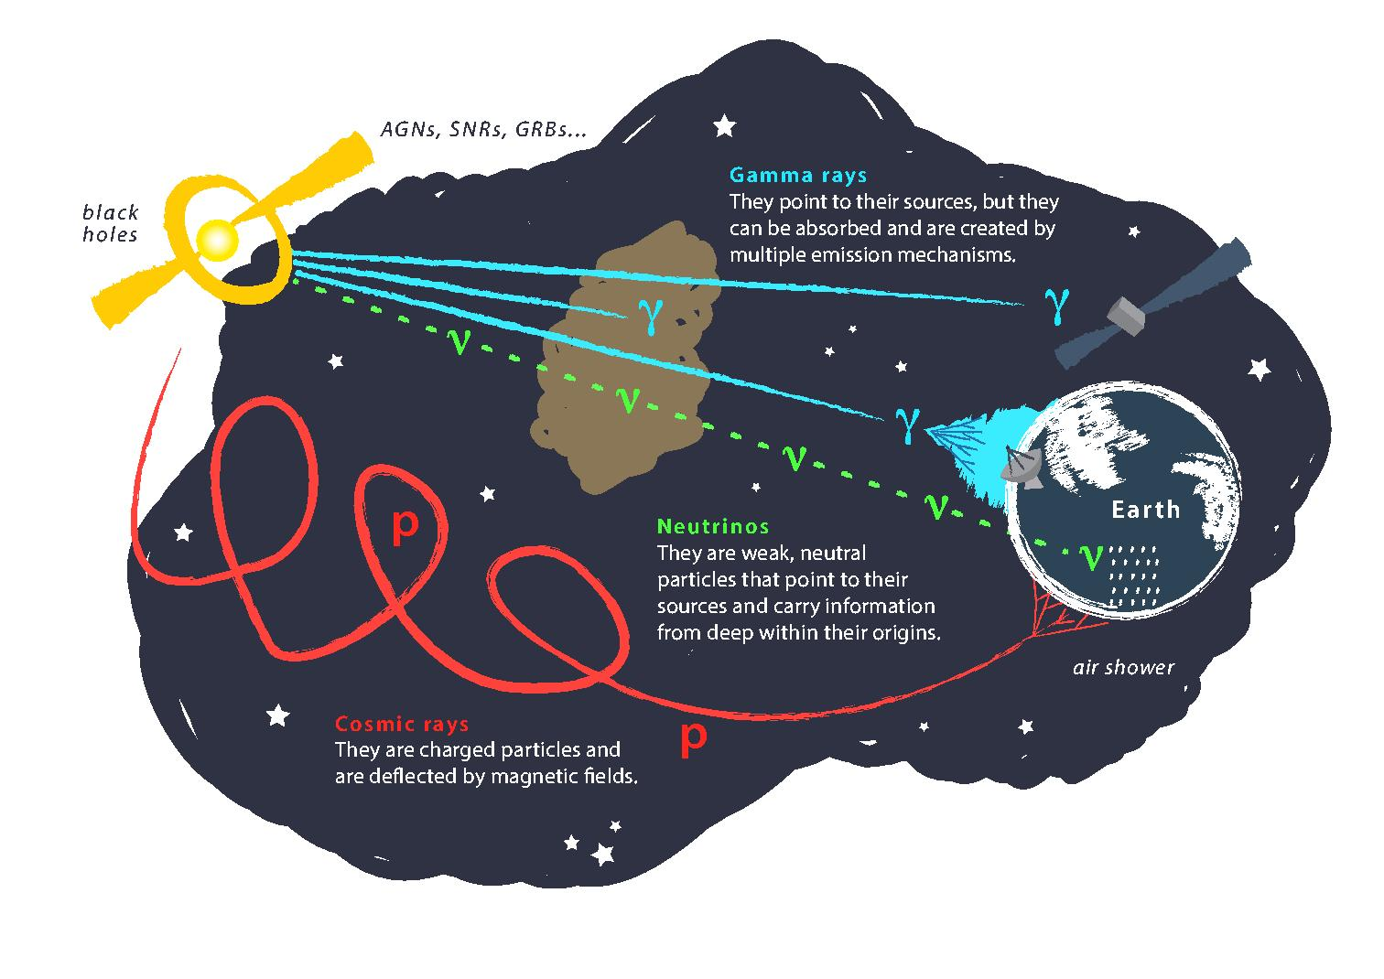
Astroparticle Physics
gallery.icecube..wisc.edu

Slide 5
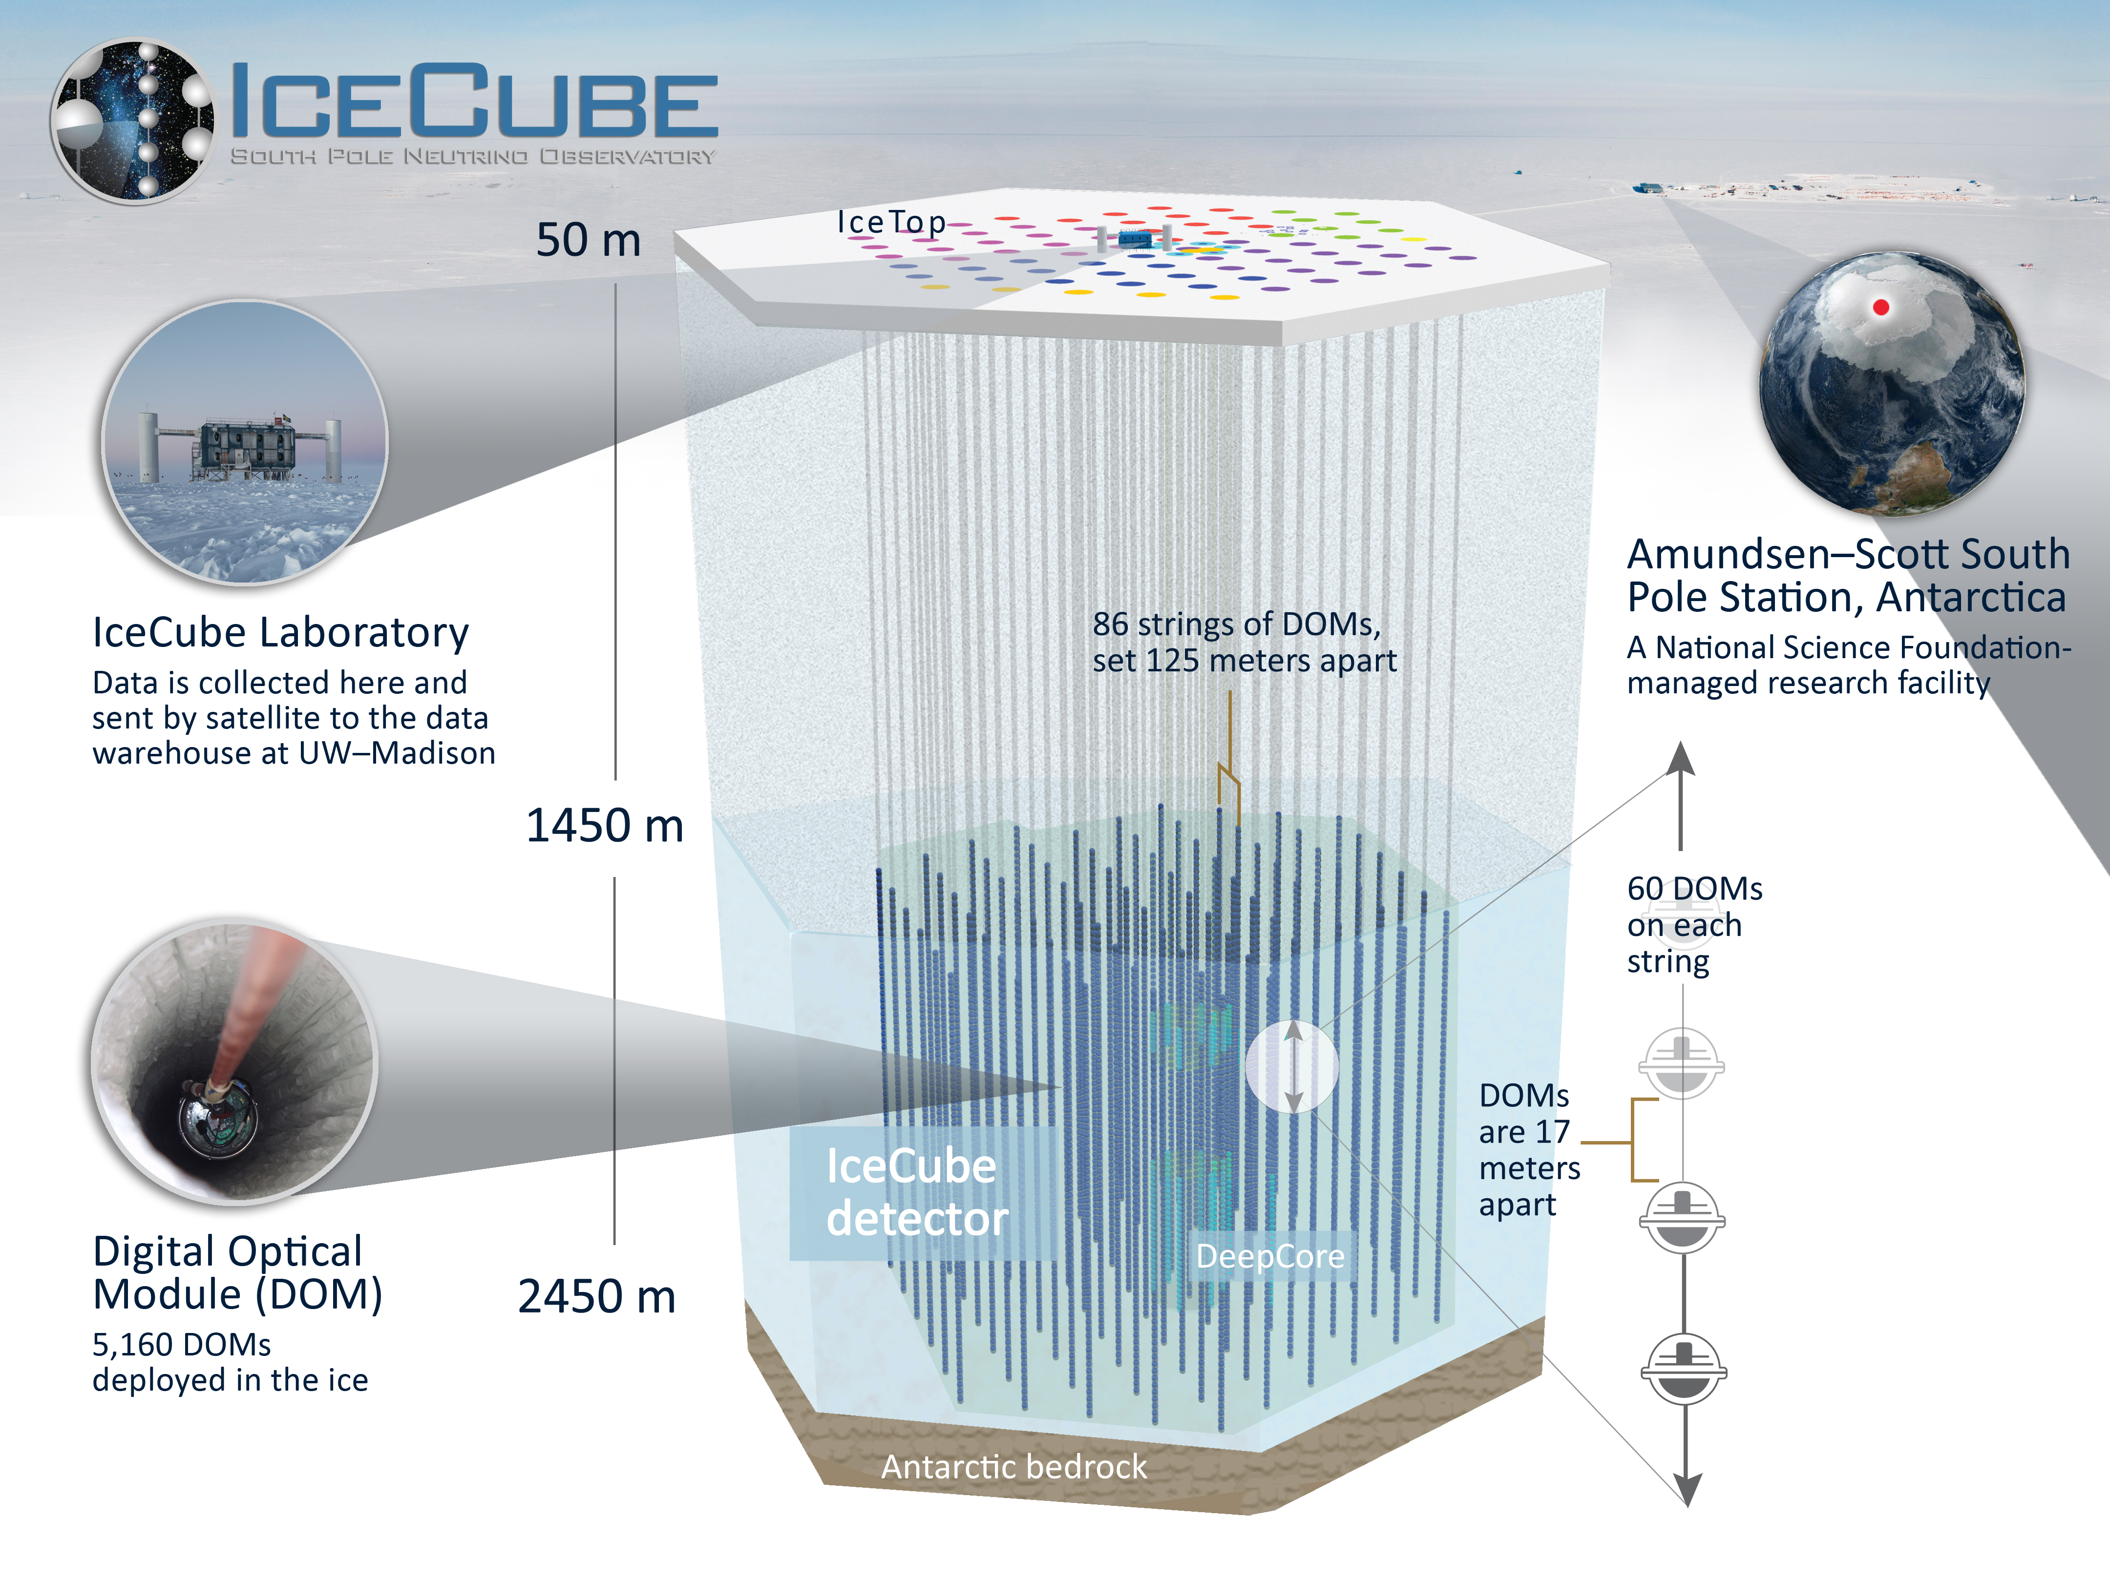
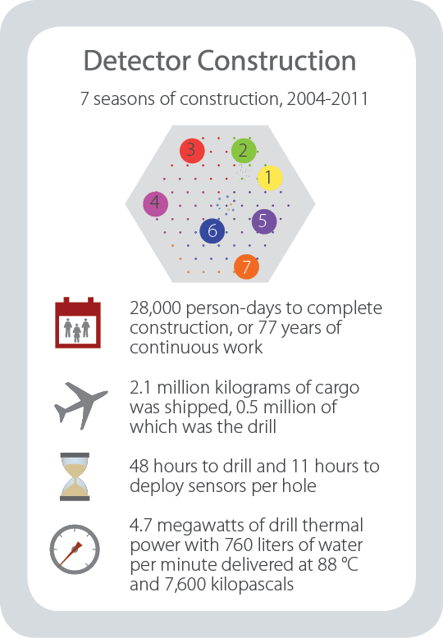
gallery.icecube..wisc.edu

Slide 6
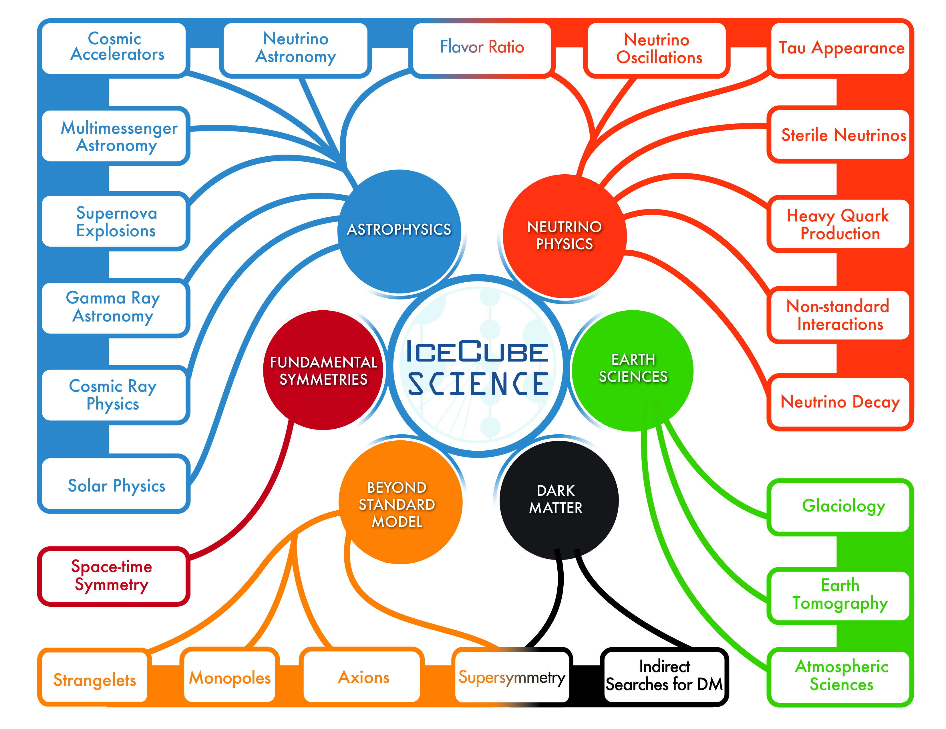
gallery.icecube..wisc.edu

Slide 7
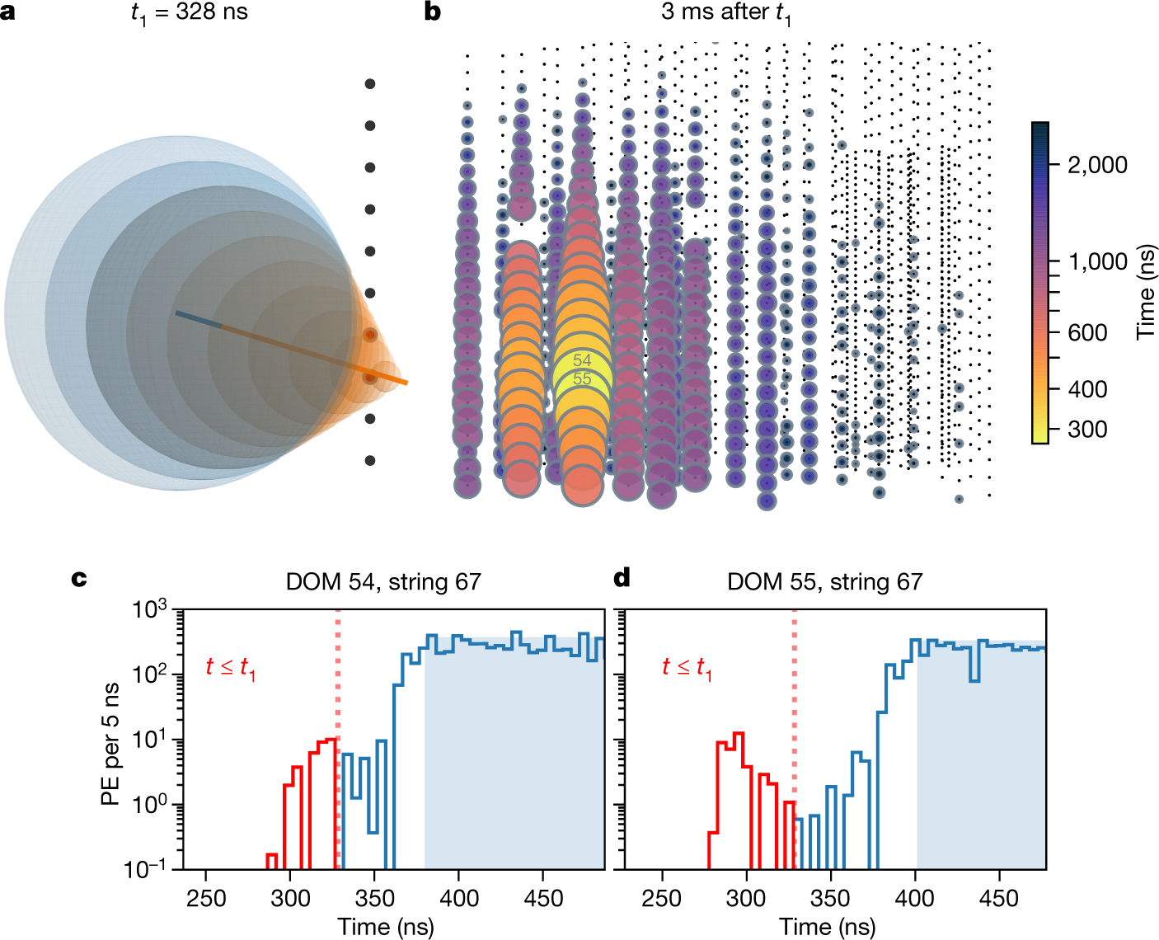
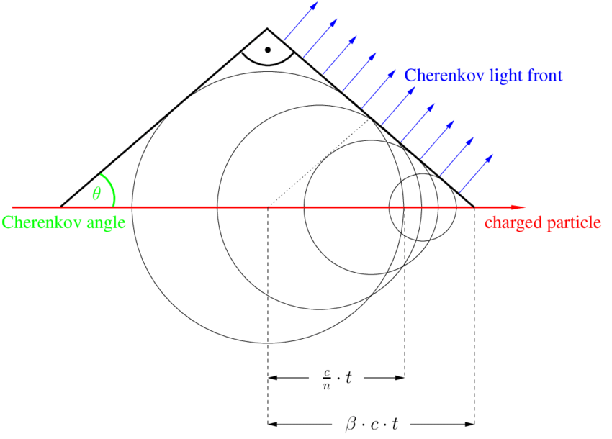
Particle Detection – Cherenkov Light
10.1038/s41586-021-03256-1
T. Gluesenkamp

Slide 8
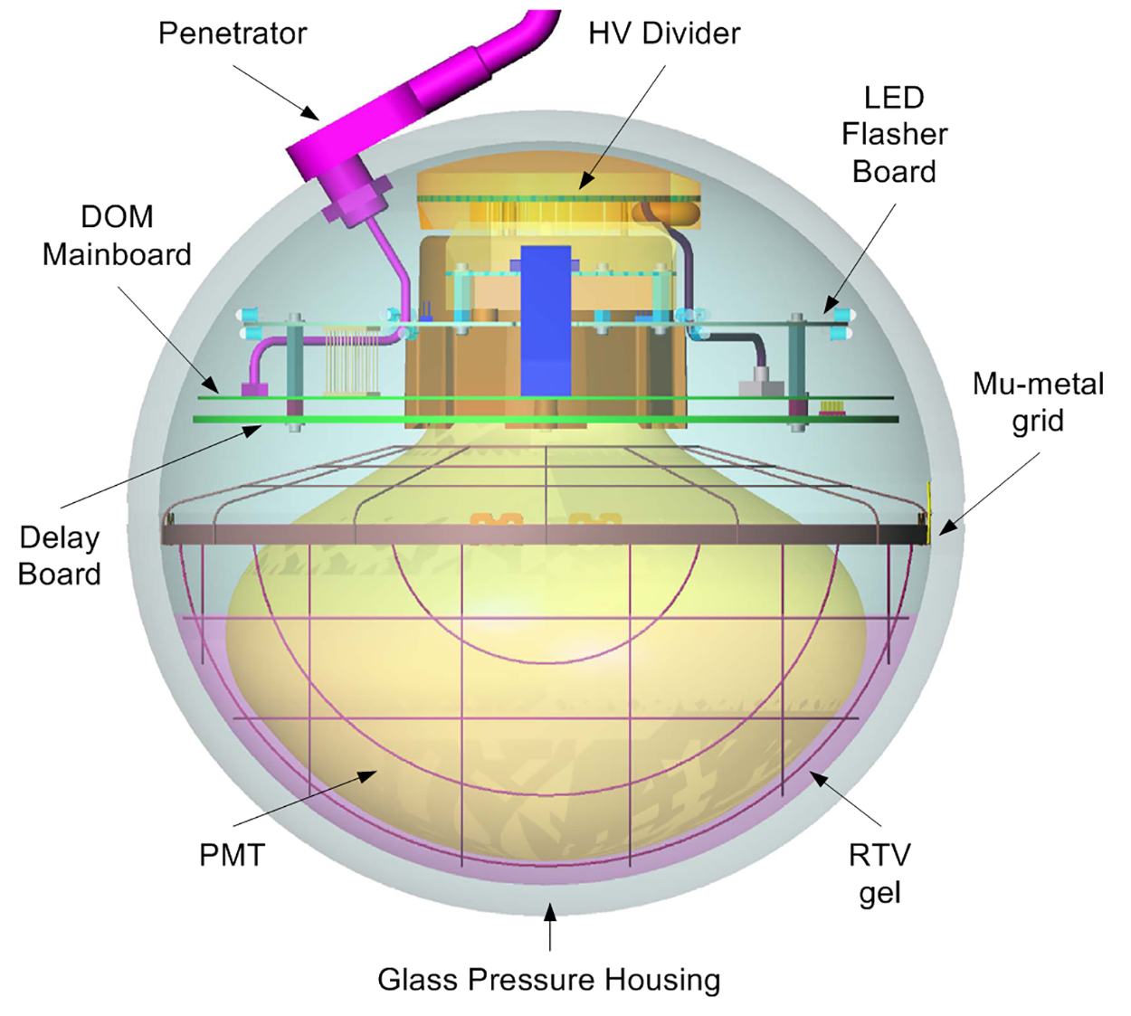
Digital Optical Module (DOM)
icecube..wisc.edu

Slide 9
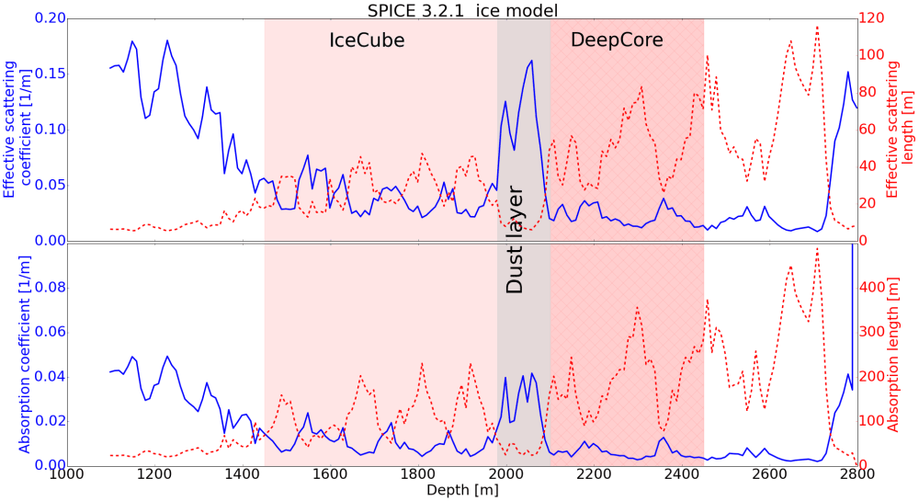
Detection Medium - Ice
icecube..wisc.edu

Slide 10
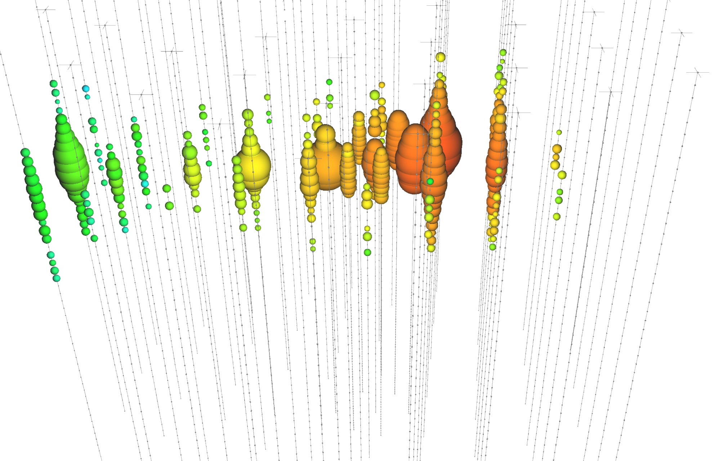
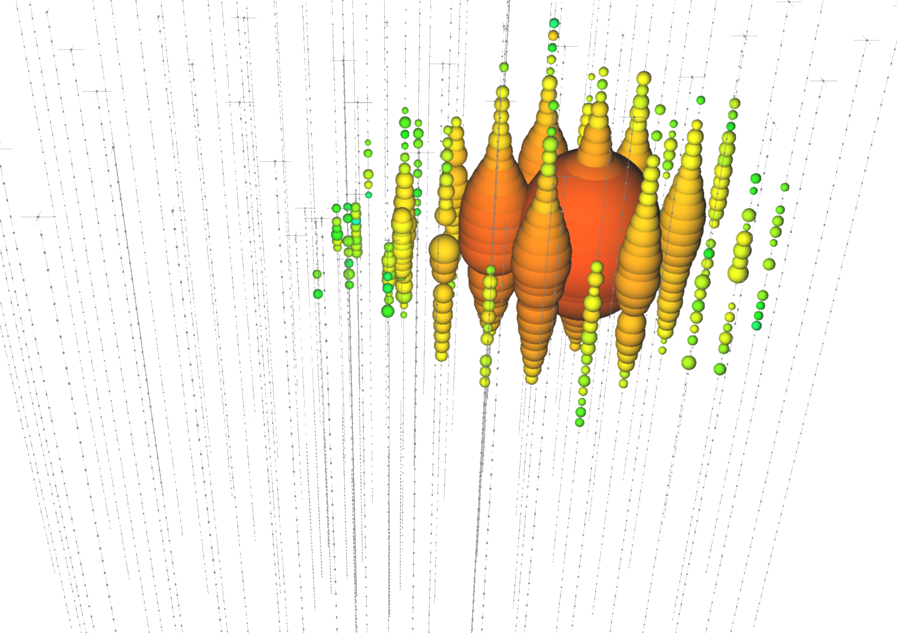
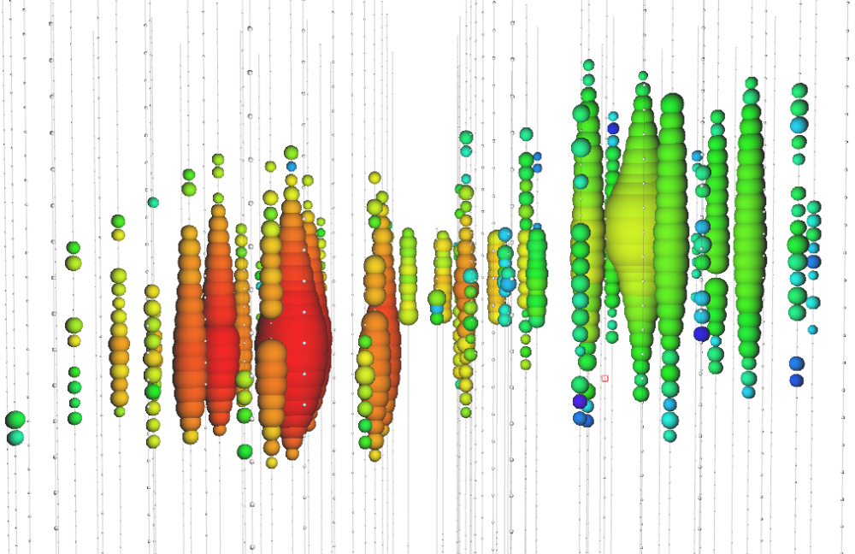
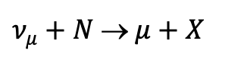
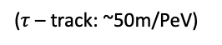
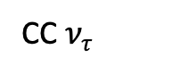
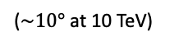
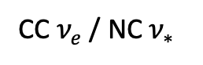
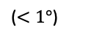
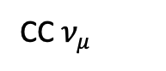
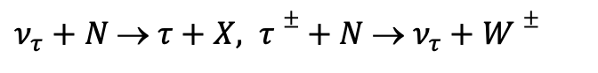
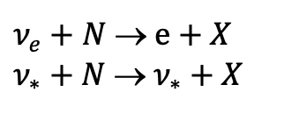
Event Topologies
CC $ν_{μ}$
CC $ν_{e}$ / NC $ν_{∗}$
CC $ν_{τ}$
icecube.wisc.edu
$ν_{μ}+N$ → $μ+X$
$ν_{e}+N$ → $e+X$
$ν_{∗}+N$ → $ν_{∗}+X$
$ν_{τ}+N$ → $τ+X, τ±+ N$ → $ν_{τ}+W±$
Track
Cascade
Cascade / Track / Double-Cascade
($<1°$)
($\sim 10°$ at 10 TeV)
($τ$ – track: ~50m/PeV)

Slide 11

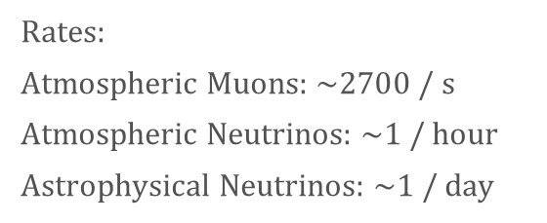

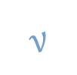


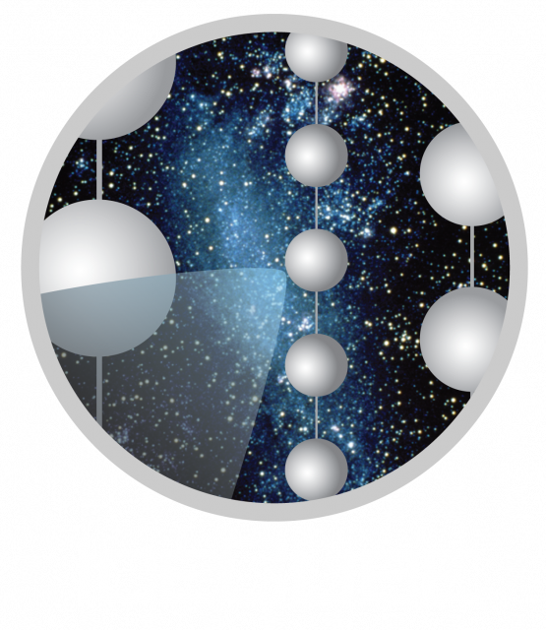
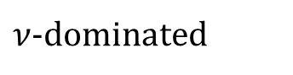
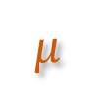
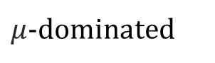
Air Shower
Astrophysical Source
Atmosphere
(not to scale)
Air shower
Air shower

Slide 12
More background

Slide 13
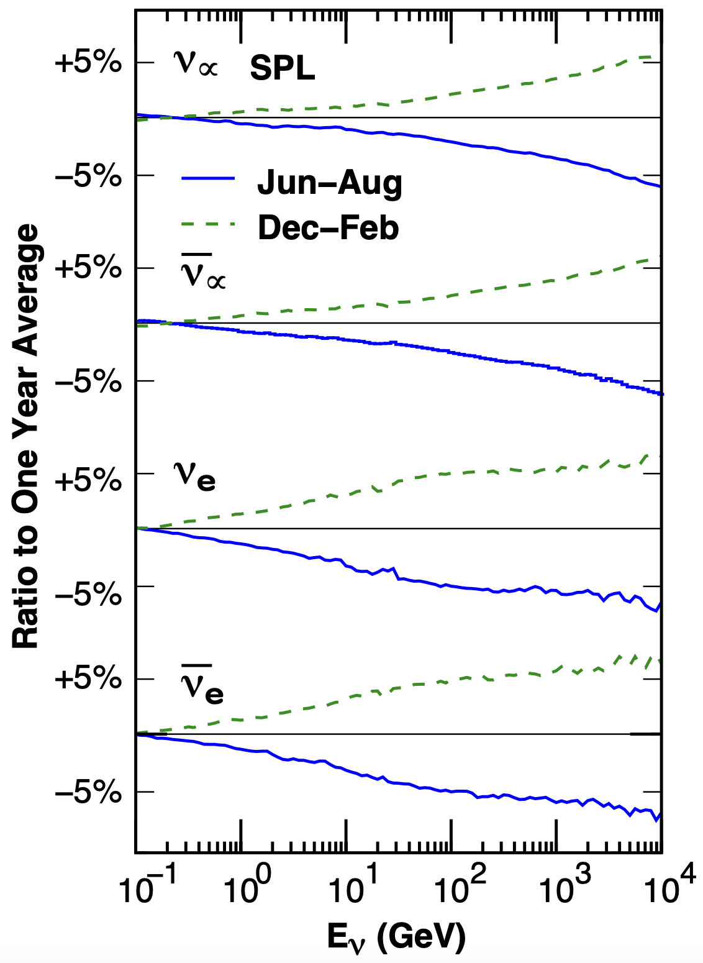
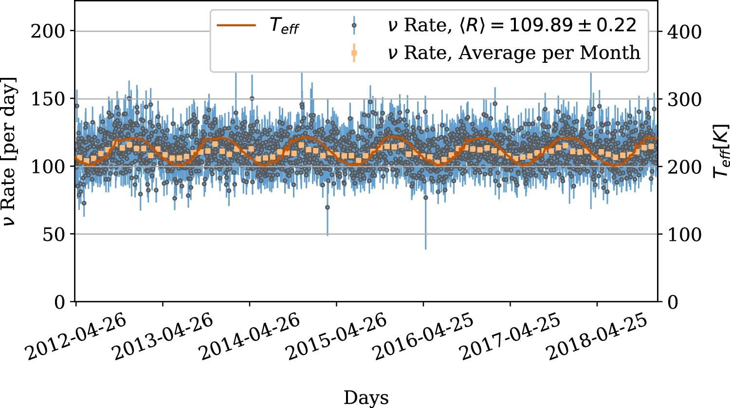
Seasonal Variations of Atmospheric Neutrinos
10.1140/epjc/s10052-023-11679-5
10.1103/PhysRevD.92.023004

Slide 14
Earth as shield

Slide 15
Muon Deflections
10.22323/1.444.1197
10.1140/epjc/s10052-022-11102-5

Slide 16
NGC 1068

Slide 17
TXS

Slide 18
Galactic plane

Slide 19
muon puzzle - observation

Slide 20
Connection to LHC

Slide 21
possible solutions

Slide 22
prompt muons

Slide 23
!! Check icecube’s homepage, there are some quick facts and stuff like that

Slide 24
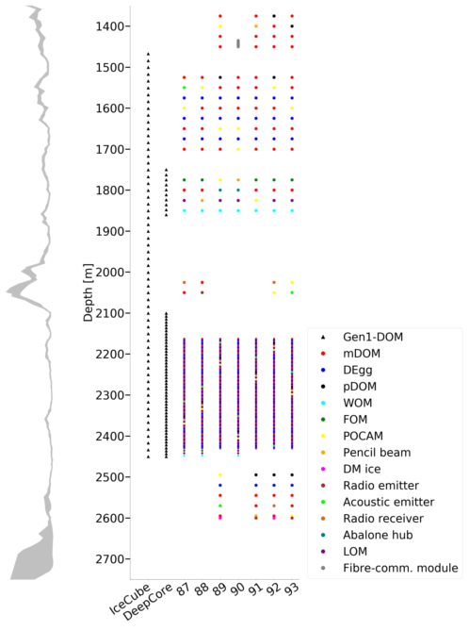
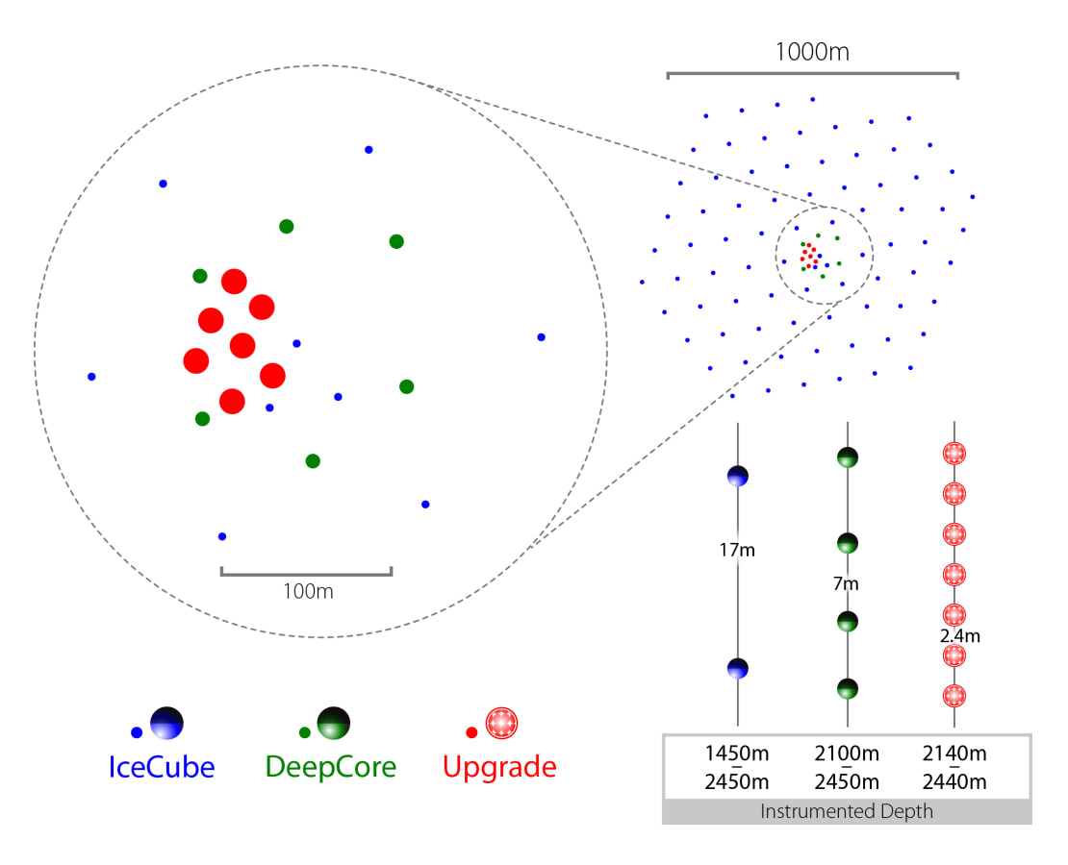
IceCube Upgrade
nbi.ku.dk
icecube.wisc.edu

Slide 25

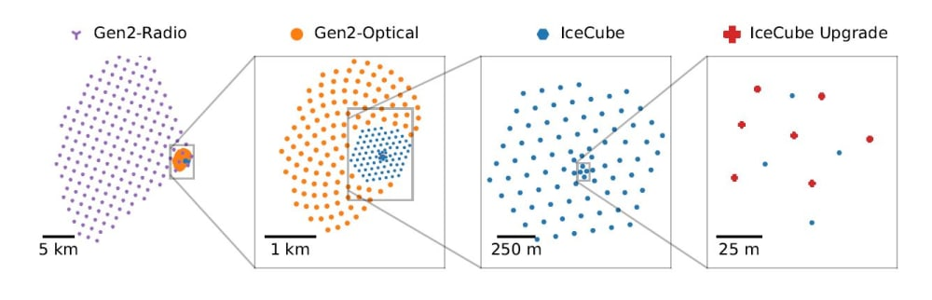
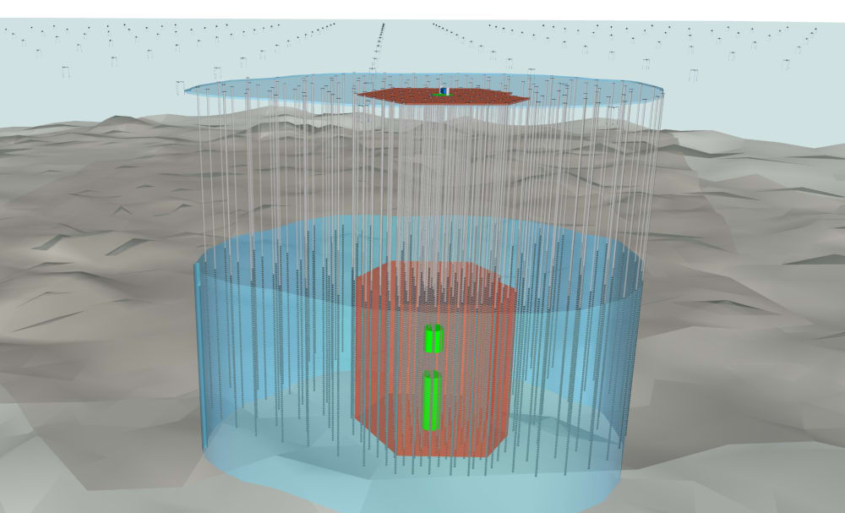
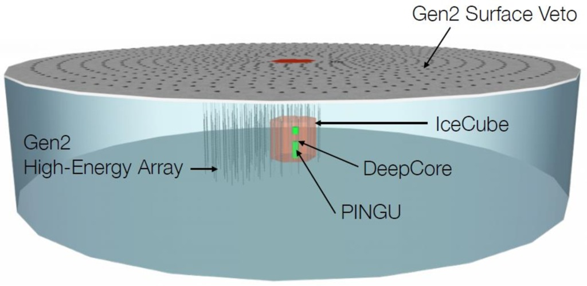
IceCube Gen-2
icecube.wisc.edu

Slide 26
Multimessenger – include IceTop etc.

